Slide 1

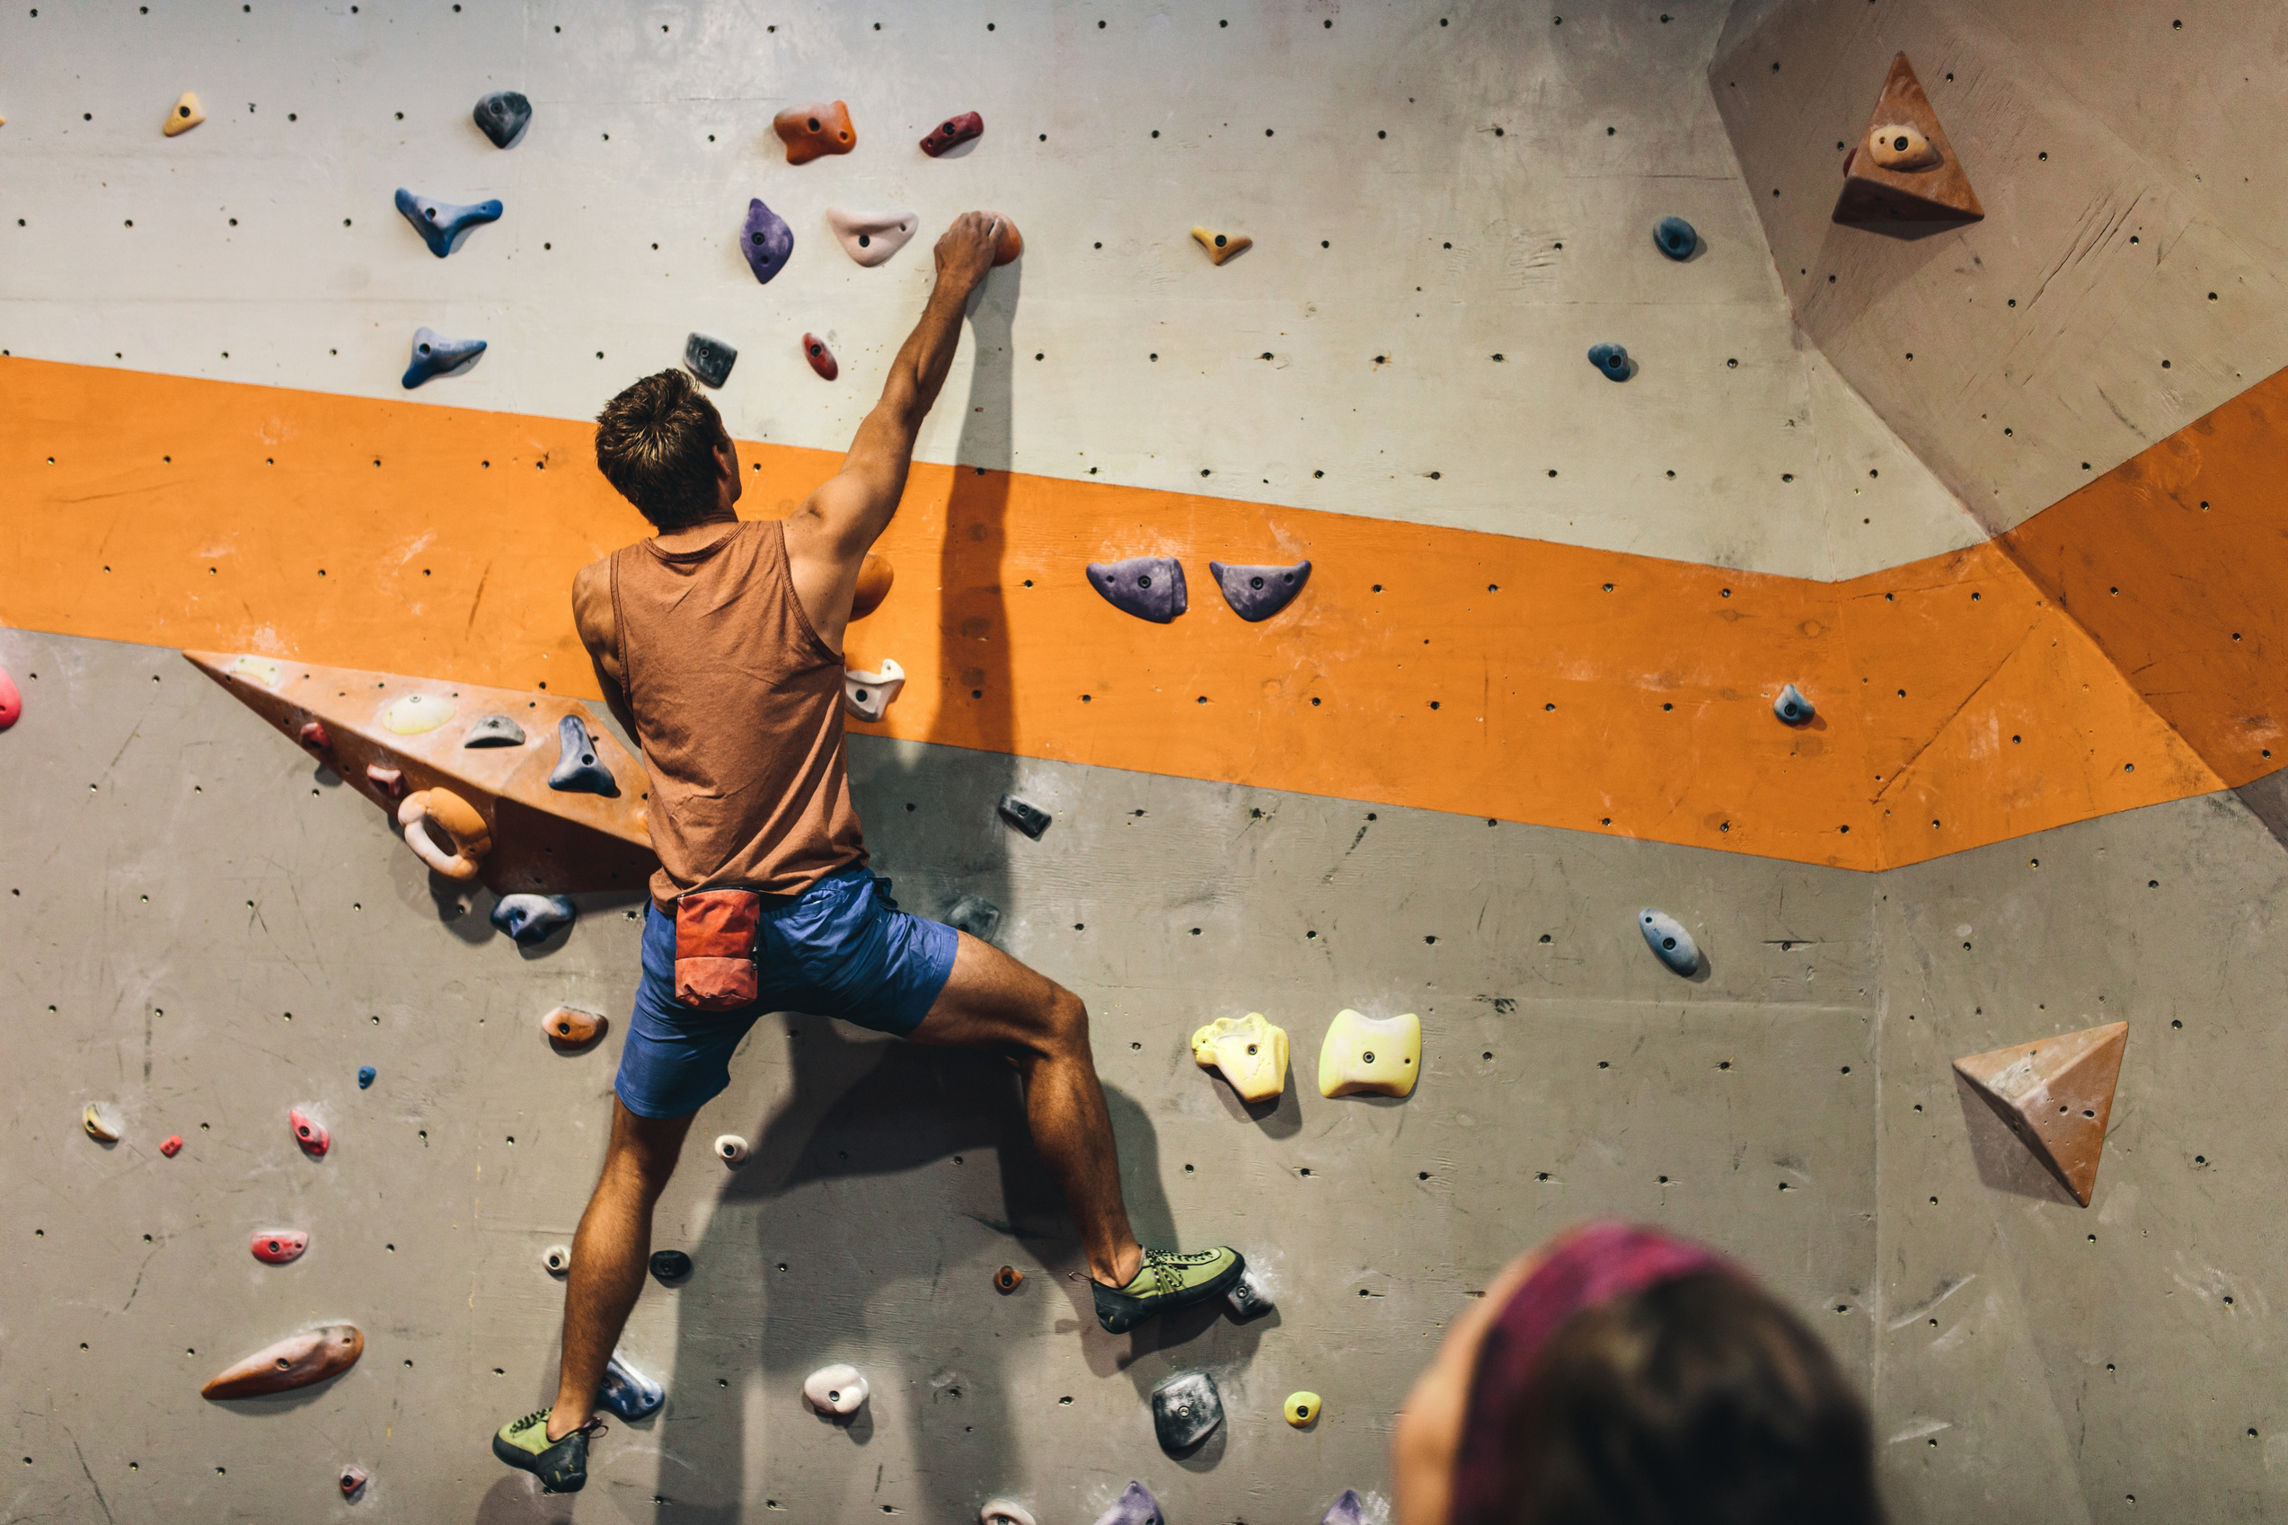

DATA ANALYST – BUSINESS INTELLIGENCE / EDITION 2024
SELECT THE
RIGHT CANDIDATES
FOR SPONSORSHIP
IN SPORT CLIMBING
A BUSINESS INTELLIGENCE
PROJECT DEFENSE
Stéphane JULLIEN
Bruxelles, DigitalCity, Sept 6th 2024

Slide 2

About Stephane JULLIEN
20 YEARS OF PROVIDING TECHNICAL SUPPORT TO INTERNAL AND EXTERNAL CUSTOMERS
IN MULTIPLE PROCESSES (MASTER DATA MNGT IN PLM/PDM AND SAP, WORK INSTRUCTION MNGT, BIOCHEMICAL PURIFICATION)
AND INDUSTRIES (BIO-PHARMACEUTICAL, RAILWAY, TRACTORS, AERONAUTICS
2002 : MASTER DEGREE IN BIOTECHNOLOGIES
2012 : LEAN MANUFACTURING / METHODES INDUSTRIELLES
2017 - 23 : MASTER DATA MANAGEMENT IN SAP AND PLM
SAP MIGRATION 60K MATERIALS & 17K MBOMS
INTERFACE PLM & ORCHESTRA TO SAP
END-USER SUPPORT IN INDUSTRIAL DATA
END USER TRAINING
ONLY EXCEL AS DATA ANALYSIS AND VISUALISATION TOOL
EXCEL TOO SLOW FOR SAP MASTER DATA MIGRATION
NO ACCESS TO IT TOOL DATABASES
IT TOOLS AND PROCESS “TOO” ALSTOM SPECIFIC OR OUTDATED : SAP R3, ...
LACK OF SKILLS FOR LARGE SCALE DATA ANALYSIS
STRENGHTS
WEAKNESSES
LOUISE GARNIER
Graphiste
DISCOVERED POWER-BI @ SONACA
EAGER TO LEARN NEW TOOLS :
DATABASE, AI, LLMS, SAP4HANA, BIG DATA,...
EAGER TO BE MORE EFFICIENT & AUTONOMOUS WITH DATA
DATA ANALYST COURSE @ DIGITAL CITY ... TO START
END OF 2023 : NO MATCH BETWEEN CV AND JOB REQUIREMENTS
IN DATA ANALYSIS AND SAP
POWER-BI, TABLEAU, SQL, SAP4HANA, SAP PLM, ...
IMPACT OF LLMS (CHATGPT) AND AI ON JOB MARKET
THREATS
LOU HUET
OPPORTUNITIES
PIERRE CHAPELLE
Community Manageer
Photographe & Vidéaste

Slide 3
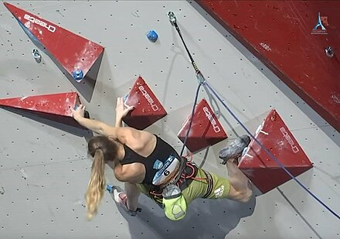
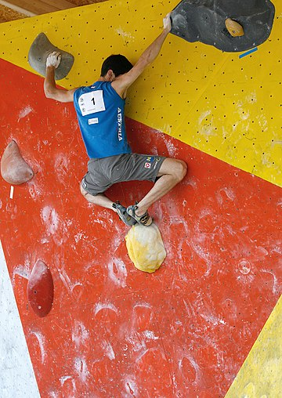
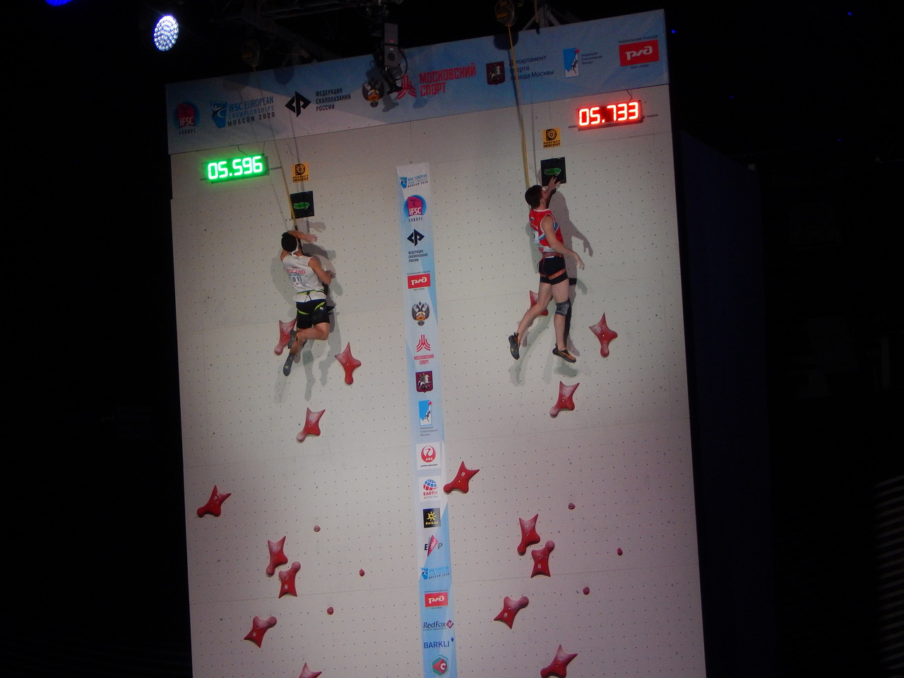
About Competition Climbing
COMBINED
LEAD
BOULDERING
SPEED
Competitors have 6 minutes to climb a 15-metre pre-bolted sport climbing route. They must also clip their safety rope into the various quickdraws while they ascend the route; failing to clip into a quickdraw terminates their climb at that position
Competitors have to "solve" multiple short 4.5-metre bouldering problems over a set time period, with the fewest falls. More complex / lead climbing. Competitors do not use a rope or any climbing protection, but crash pads that are laid across the ground for safety
Competitors must race against the clock a 15-metre, standardised climbing wall, where the holds are always the exact same size and placed in the exact same location. As the emphasis is on speed, the climbers use an auto-belay top rope for protection.
https://en.wikipedia.org/wiki/Competition_climbing

Slide 4
About Competition Climbing
DISCIPLINES :
Lead
Bouldering
Speed
Combined
Summer Olympics
IFSC World Cup
COMPETITIONS:
Worldwide only
IFSC World Championship
RANK:
Gold
Silver
Bronze
Youth_B
14 - 15 yo
Youth_A
16 - 17
Junior
18 - 19
Senior
20 and over
AGE CATEGORIES:
years old
GENDER

Slide 5
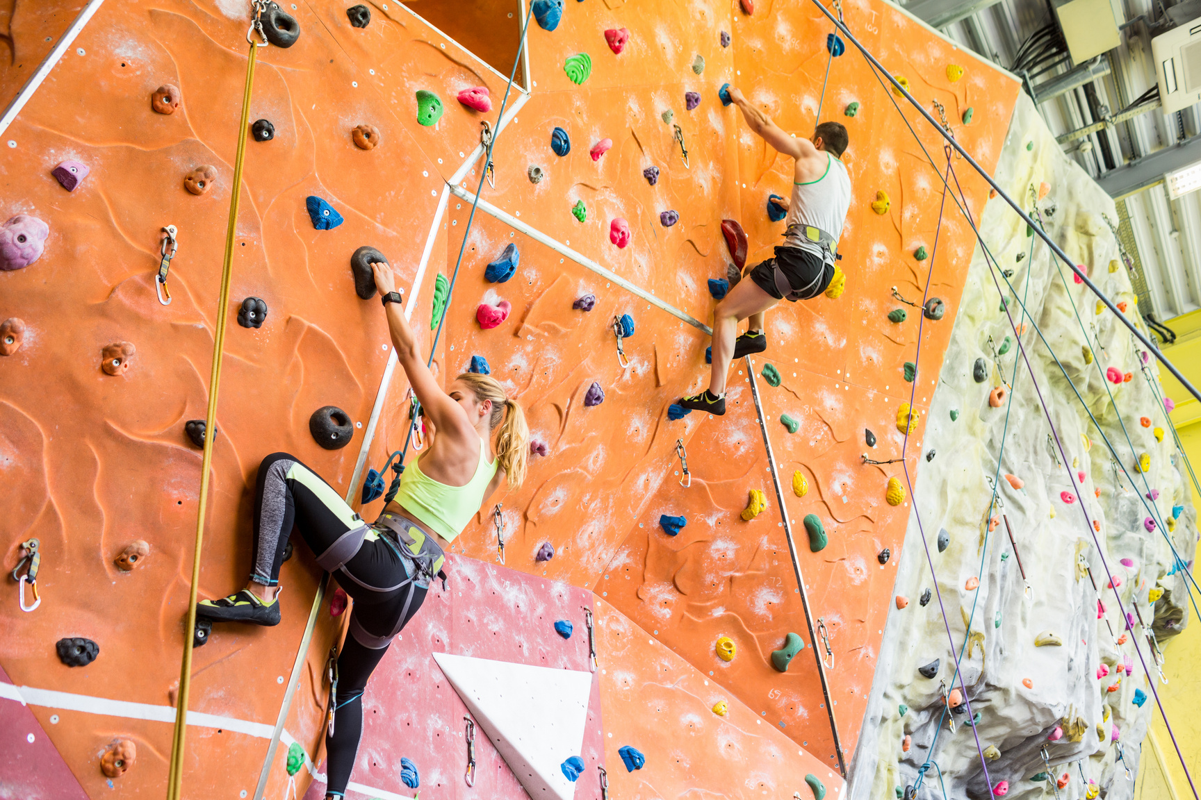
BI Project
Context
A worldwide company specialized in Climbing Furnitures
Has developed a connected climbing harness
The marketing team suggests sponsorship of some competition climbers :
2 World Senior Competition Climber (1 M / 1 F)
2 Future Stars (1 M / 1 F) < 18 years in 2024:
A National Team
The Top Management requests his newly Data Analyst to provide Top 3 Names for each
Data Analyst’s solution : create a database gathering Climbers performance ranking in worldwide competitions, and over the years. Idem for Nations.

Slide 6
Sources, Process and Technologies
Lot of Climbing content in webpages,
1 dataset (2 csv > 9000 lines) on kaggle
Data on Nations (PIB, Age, Altitude, ... ) in Wikipedia
Search
Google Dataset Search,
Kaggle, ChatGPT, Wikipedia
Google Form (draft),
Mails to Bxl climbing gyms,
Mail for Requesting API key
Ask
Time spending
No answer
Wikipedia : html tables (compatible)
~ 30 tables / webpage :
no standard structure > no automatization
legends in data frame, comma missing,
Competitor Nation displayed in icon in
html and not webscrapped :
languages of Nation names
decimal comma disappearing
Webscrapping : Python Pandas + BeautifulSoup
Pandas df. : delete multiindexing, column rename, type changes, slicing, ...
Extract
Clean
Other websites:
no html tables > Selenium, API Call,
Or no access (firewall, ...)
PowerQuery on webpages ? results

Slide 7
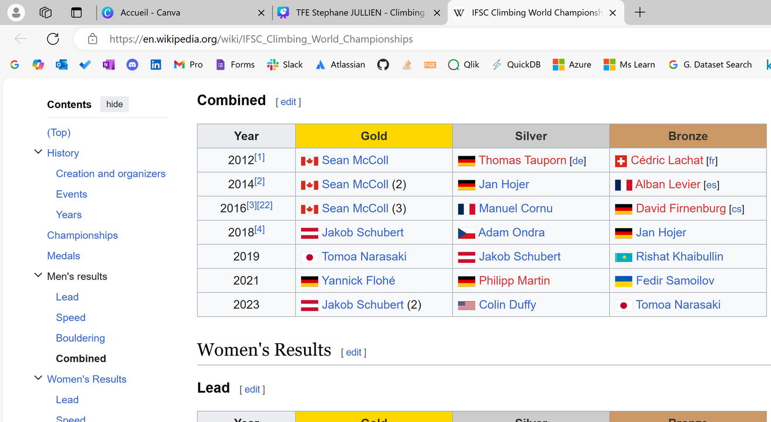
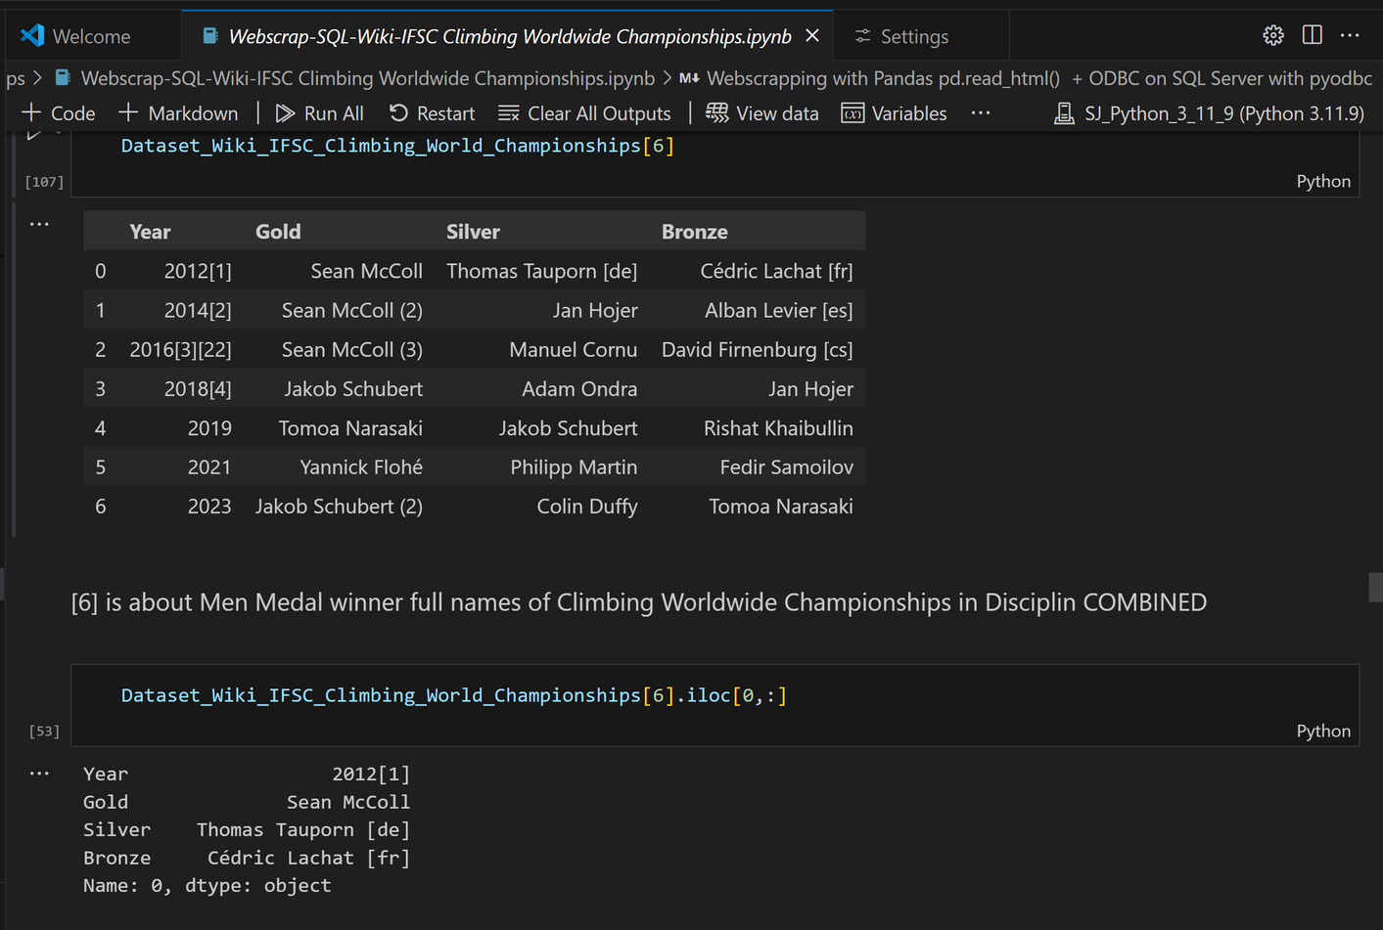
Sources, Process and Technologies
Load in DB Staging
Python connected to SQL server : pyodbc for connecting and populate tables in SQL server
DBMS SQL Server SSMS
Merge Tables with Python before loading in DB Staging

Slide 8
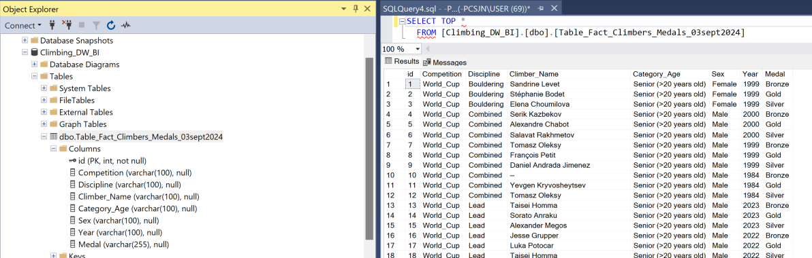
Sources, Process and Technologies
ETL within
DB Staging
SSIS to clean data and gather competitor tables to 4 tables (1 / competition), add extra columns
Cleansing : done in Python and tables reloaded into SQL Server
‘Year’ Type (Int or Str), Extra columns- in Unicode
SSIS : Unpivot Climber - Medal
> 1st Fact Table : “Competitors - Medals” (2088 records)
> 2nd Fact Table : “Nations - Medals ”
> 4 Dim tables : GDP/inhabitant, Median Age, % by Category of Age, Altitude, ...)
ETL to DW

Slide 9
Sources, Process and Technologies
Data Viz
PowerBI from DW in SQL Server
Data Transformation

Slide 10
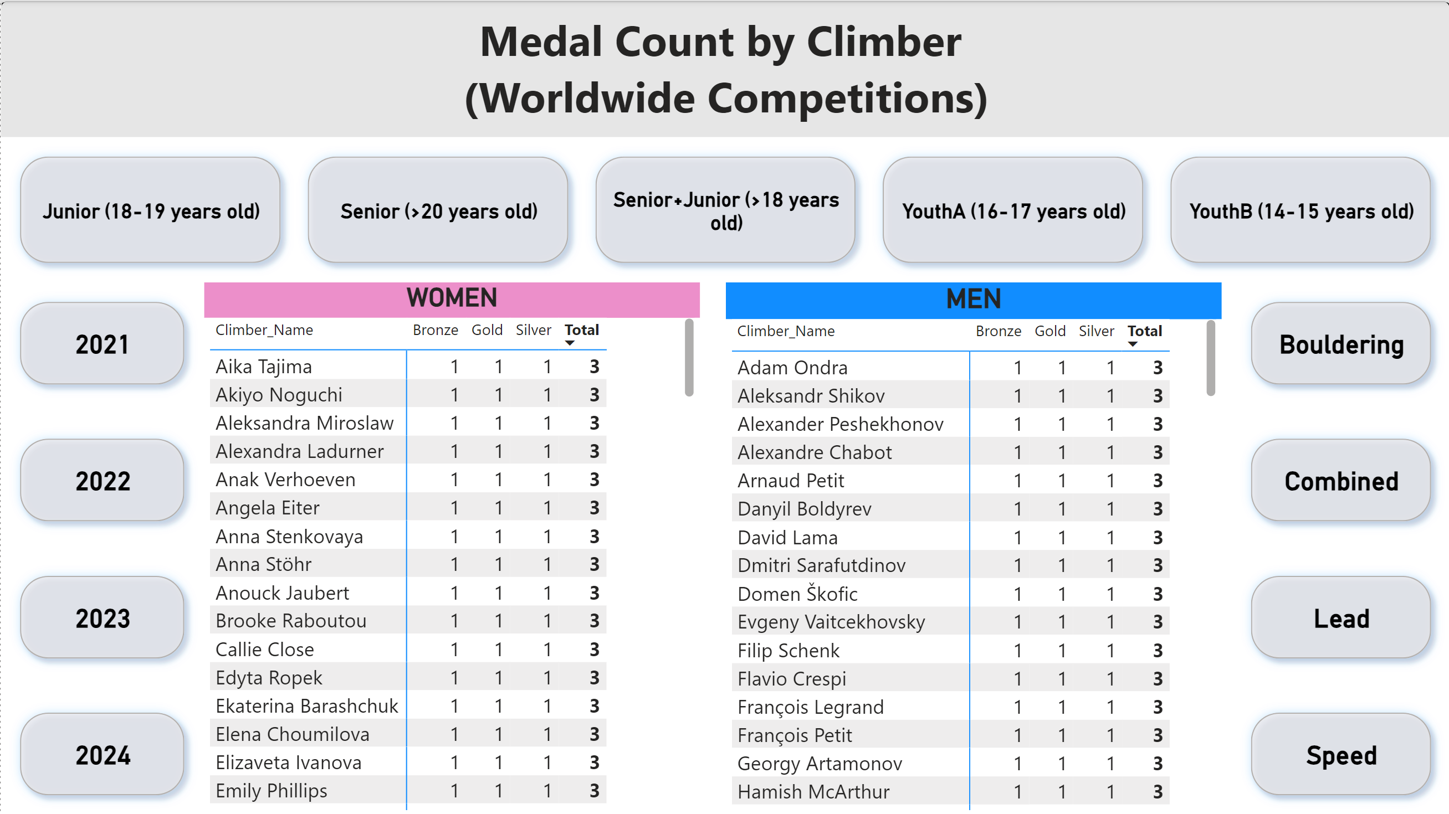
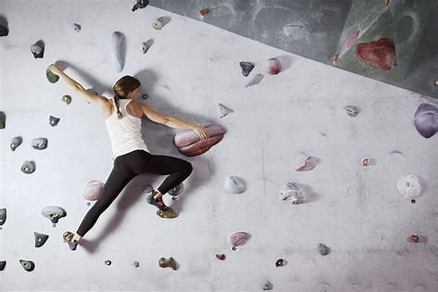
Business : Which climbers sponsorised ?

Slide 11
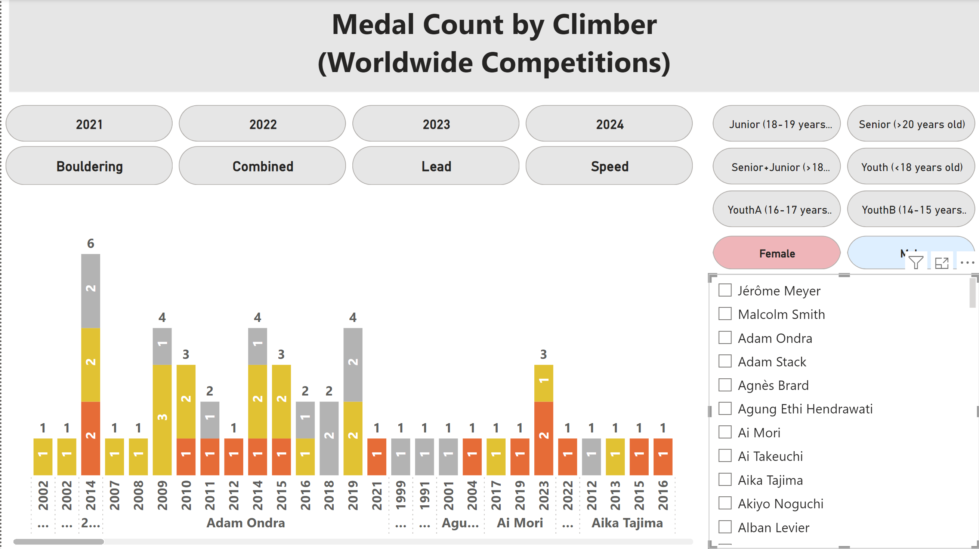
Business : Which climbers sponsorised ?

Slide 12
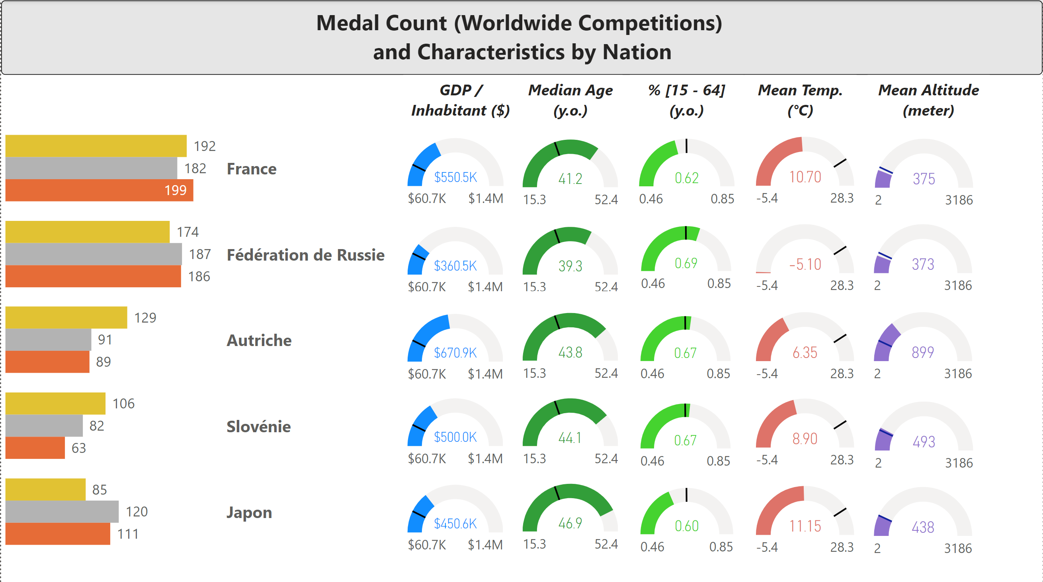
Business : Which Nation sponsorised ?

Slide 13
DATA ANALYST – BUSINESS INTELLIGENCE / EDITION 2024
CONCLUSION
&
THANK YOU
Stéphane JULLIEN
Bruxelles DigitalCity, Sept 6th 2024

Slide 14
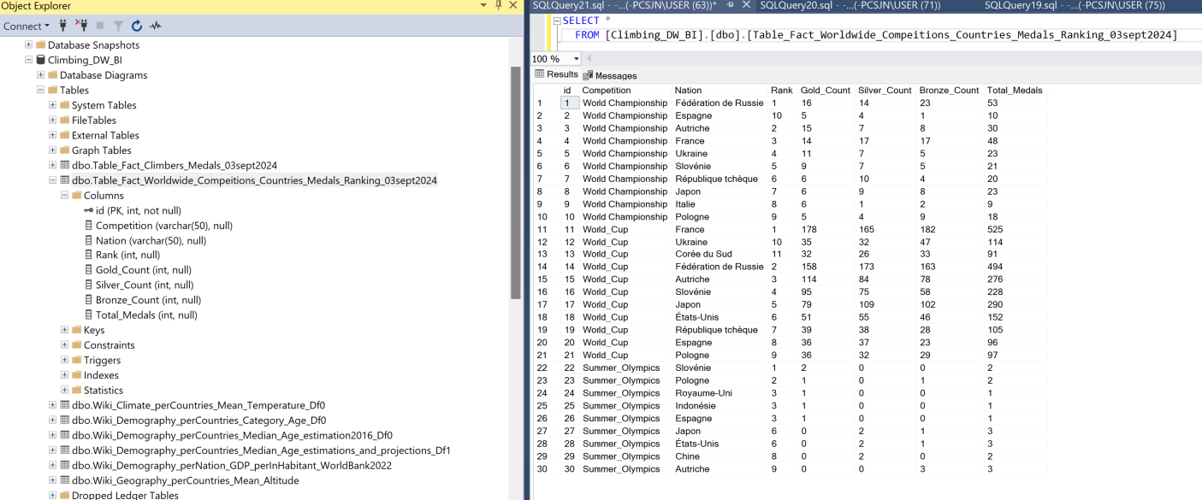
Appendix

Slide 15
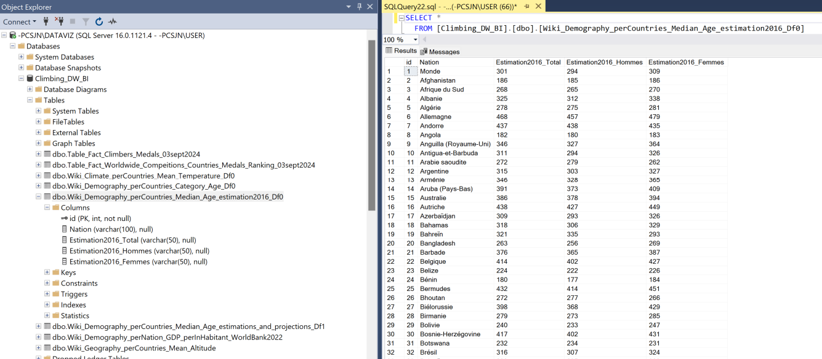
s.jullien@bruxellesformation.brussels
Appendix

Slide 16
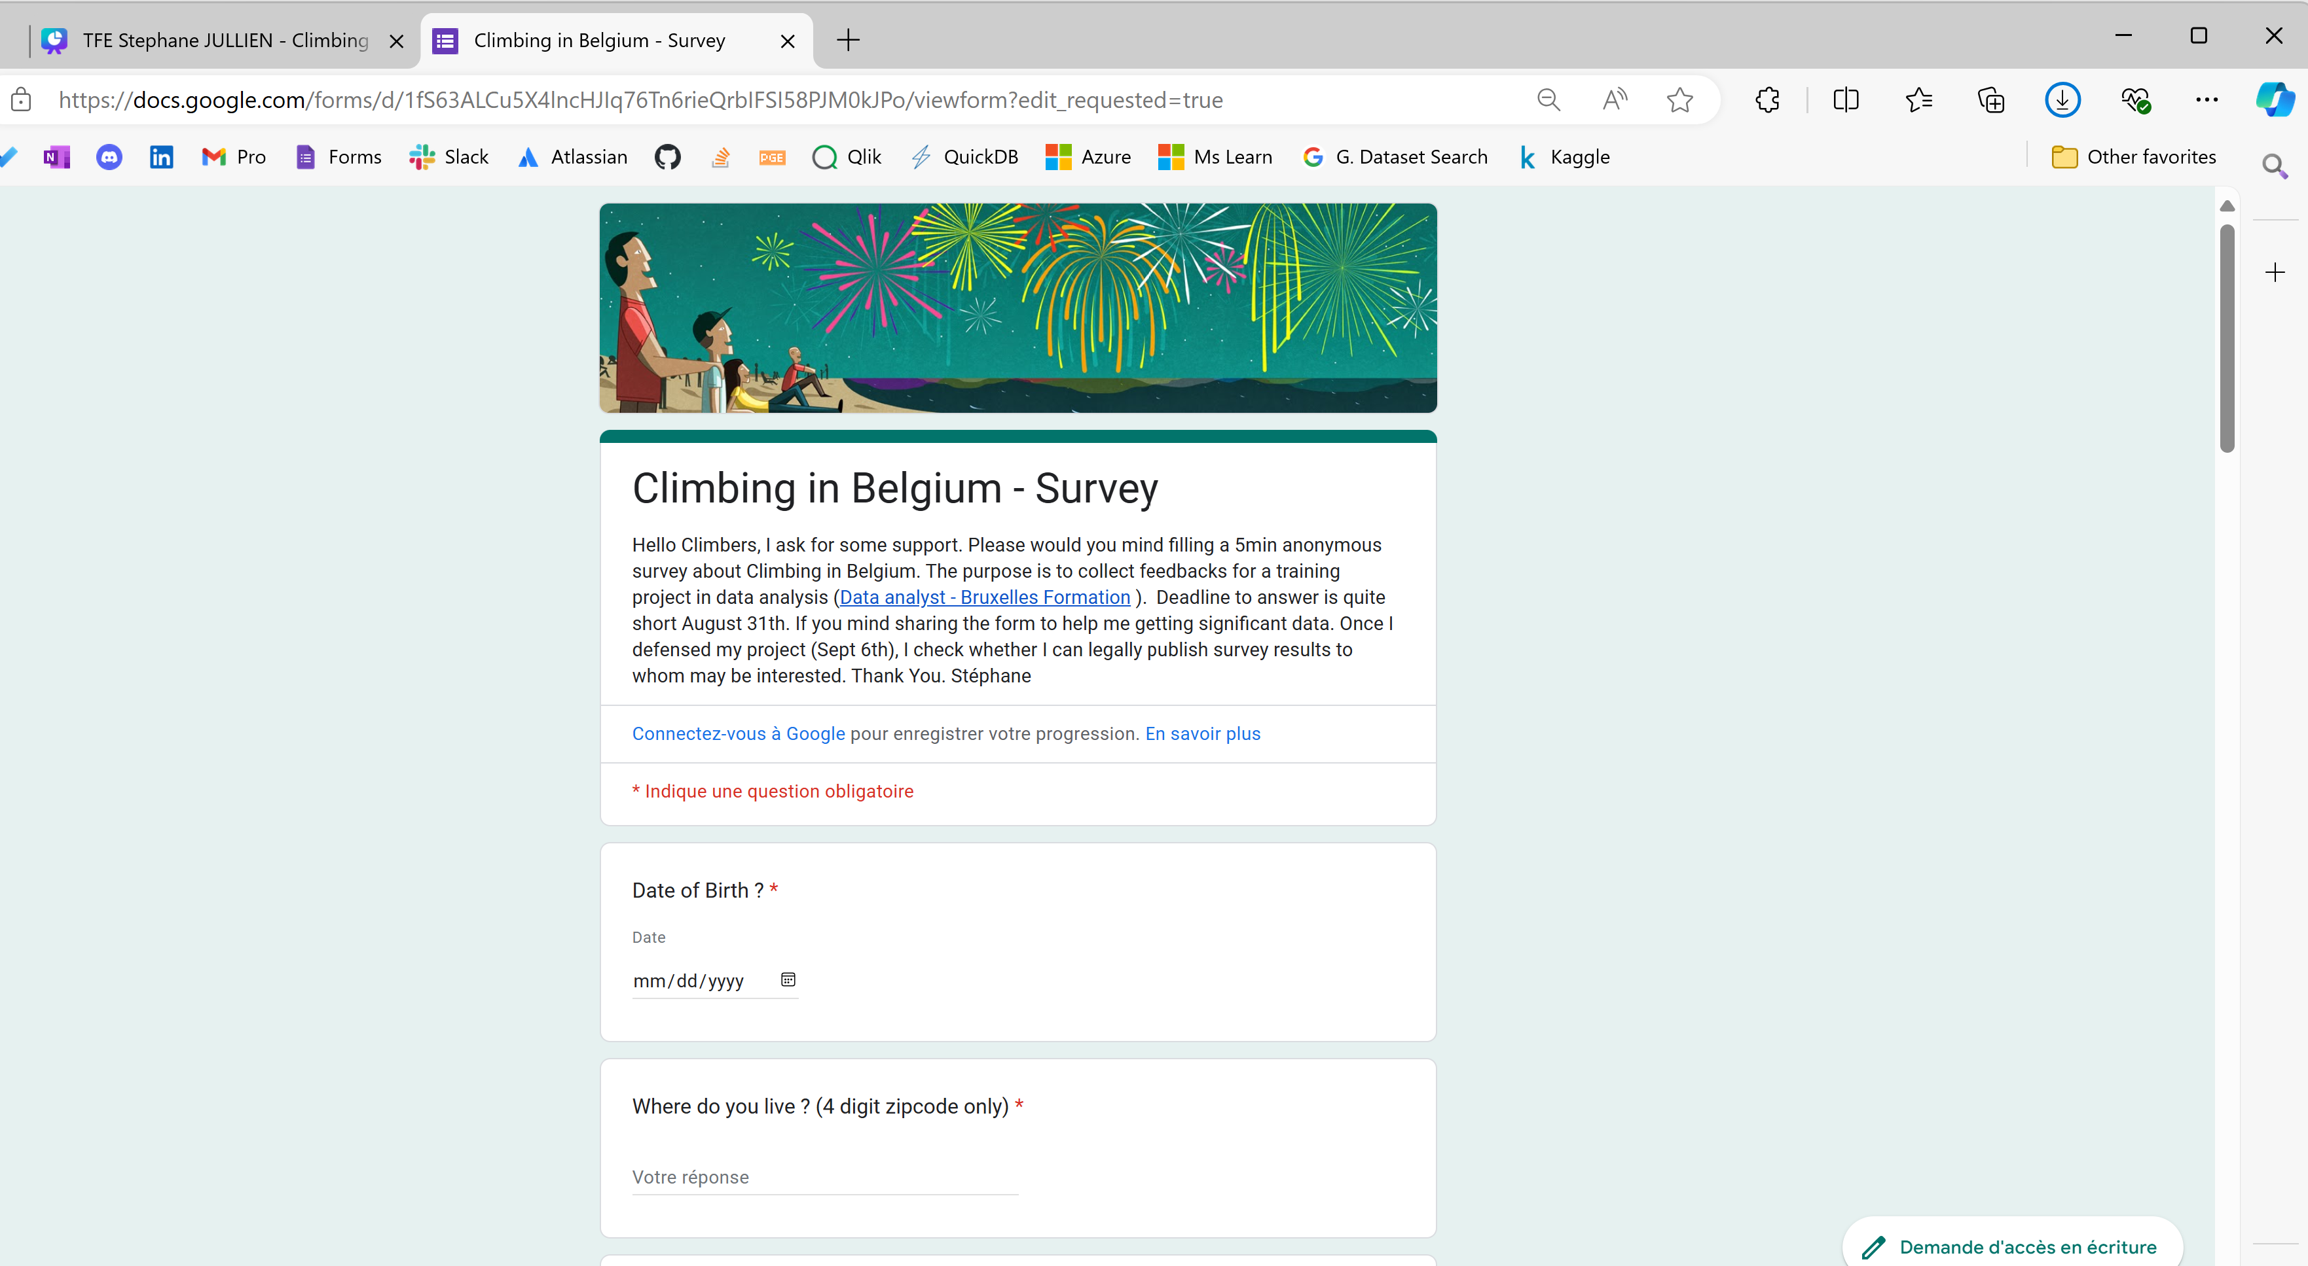
Appendix

